Slide 1


Let Their Voices Be Heard:
Incorporating marginalized & excluded composers in the Choral Classroom
Matthan Mrkvicka

Slide 2
Sesson Goals
Access a diverse repertoire of choral music that represents a variety of lived experiences and supports students’ musical growth.
Explore diverse music, both in existing arrangements and in the public domain that can meet the musicianship of your singers.
Including voices not often heard in the choral classroom.
Arranging music in the public domain for a variety of ensemble types and levels of musicianship.

Slide 3

Accessing Choral Repertoire of marginalized composers

Slide 4
Best Practices
    Going to composers from a given community/lived experience
    Ensure permission
    Considerations for Native American/American Indian Music
    Purchase ethically, respect copyright
    Discuss cultural relevance, avoid ‘flashy’ or ‘interesting’ pieces for entertainment’s sake
    Focus on the skills a piece can teach, and the perspectives it can bring into your rehearsal (just like any other piece!)

Slide 5
Best Practices
Consider the composer/arranger's connection to the culture and community
Be aware of culture bearers
Music should be experienced by everyone (outside of specific religious music)

Slide 6
Pitfalls to avoid
    Arrangers from outside the community/lived experience (be aware of culture-bearers)
    Arrangements that do not consider the cultural significance of the original piece
      Rhythms and instruments not connected to the culture (with consideration for the choral setting)
      Settings and arranging styles that are antithetical to a genre
    Arrangers that ignore the usage or intent of the original music

Slide 7
Available and Accessible Repertoire

Slide 8

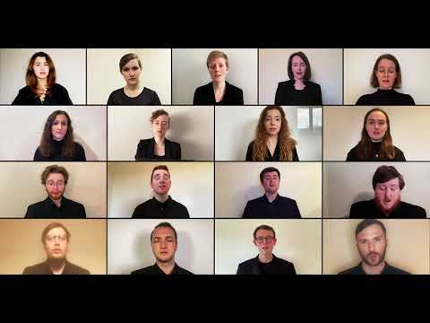
Domine tu mihi lavas pede by José Maurício Nunes Garcia
Sacred Motet, SATB
High School choruses and beyond

Slide 9
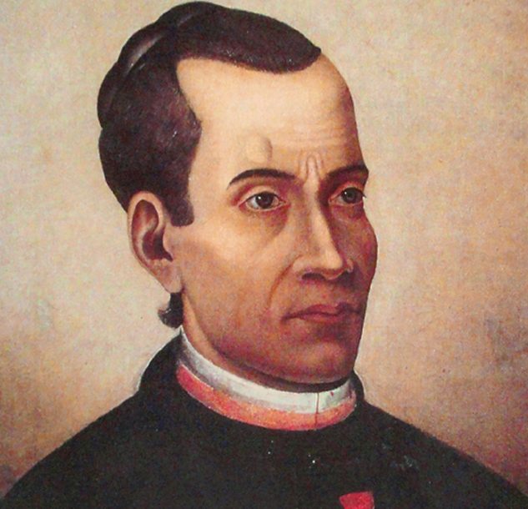
José Maurício Nunes Garcia
(1767-1830)
Born in Rio de Janeiro to a family of African and European heritage
Prodigy singer, guitarist, and harpsichordist
Joined the Priesthood
Appointed Master of the Royal Chapel

Slide 10

Domine tu mihi lavas pede
Great introduction to Motets
Mostly homophonic
Simple and repetitive Latin text
Conversations about Brazil through a familiar genre
Available right now on CPDL
This Photo by Unknown author is licensed under CC BY.

Slide 11
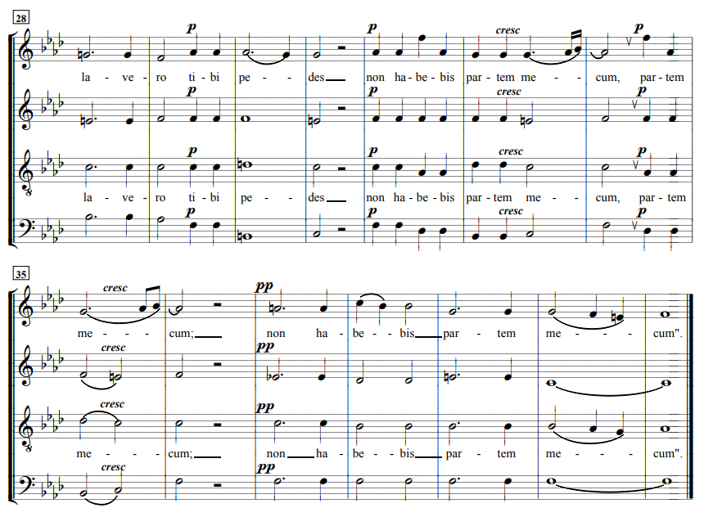

Slide 12
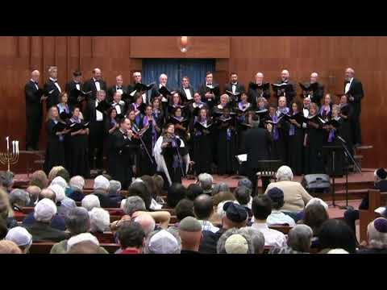
OCHO KANDELIKAS (SATB CHOIR) EIGHT CANDLES by Flory Jagoda, Arranged by Joshua Jacobson
SATB Ladino (Jewish folk song of the Sephardic, or Spanish Jews)
High School and Beyond

Slide 13
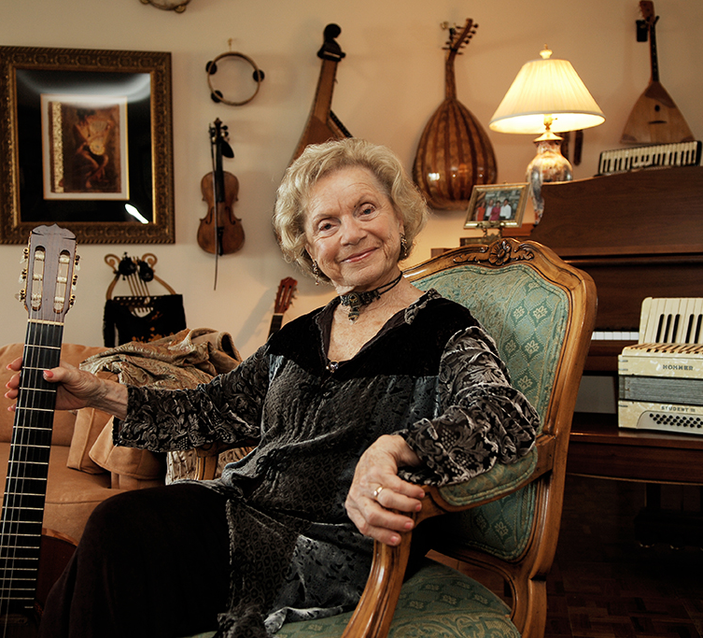
Flory Jagoda
(1923-2021)
Born in Bosnia but her family was forced to flee in 1941
Married Harry Jagoda, a US soldier and settled in Virginia
Recorded many Sephardic songs she learned from her grandmother

Slide 14
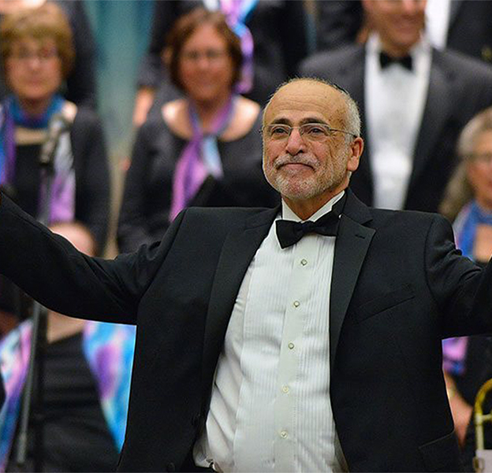
Joshua R. Jacobson
Born in 1948
One of the foremost authorities on Jewish choral music
Bachelors degree in Music from Harvard College, a Masters in Choral Conducting from the New England Conservatory, a Doctor of Musical Arts from the University of Cincinnati, and a Doctor of Humane Letters honoris causa from Hebrew College
Written articles on various aspects of choral music, and over one hundred published compositions and arrangements.

Slide 15
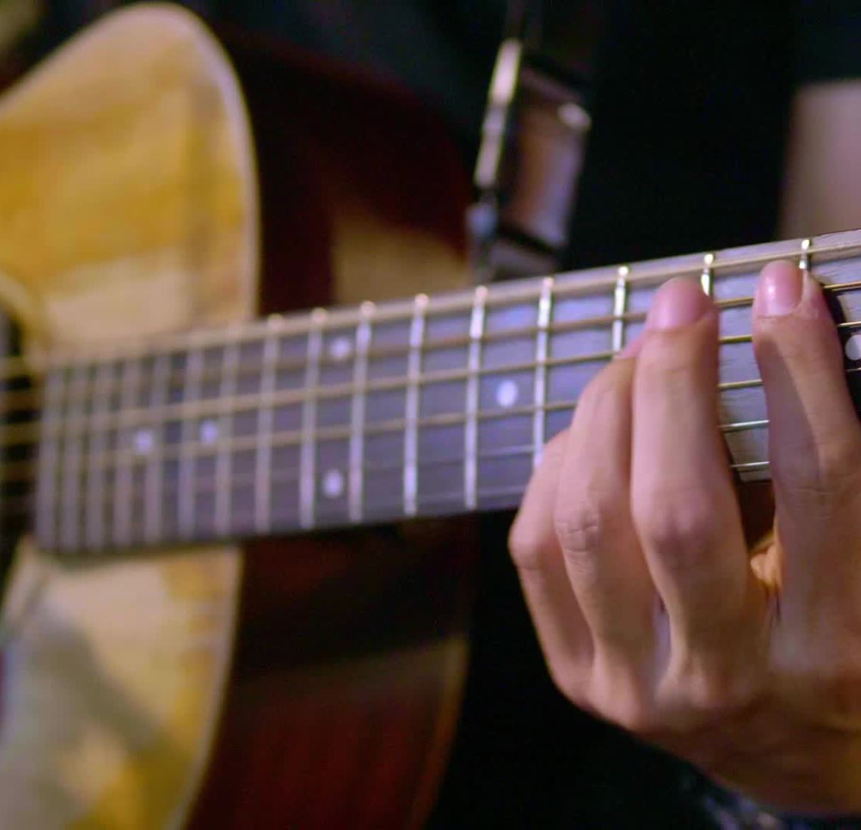
OCHO KANDELIKAS (SATB CHOIR) EIGHT CANDLES
Ladino, or Judeo-Espanyol
Memories of Chanukah from Flory's childhood
Representation for an underrepresented culture, and a language fighting extinction
Collaborate with multiple instruments: guitars, castanets, tof, tambourine
Historical curriculum connections
Available on Transcontinental Music Publishing's and various sheet music sites

Slide 16
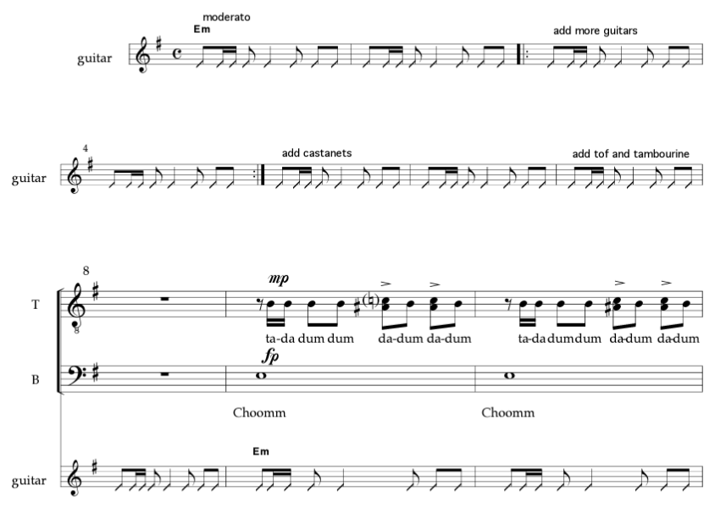

Slide 17
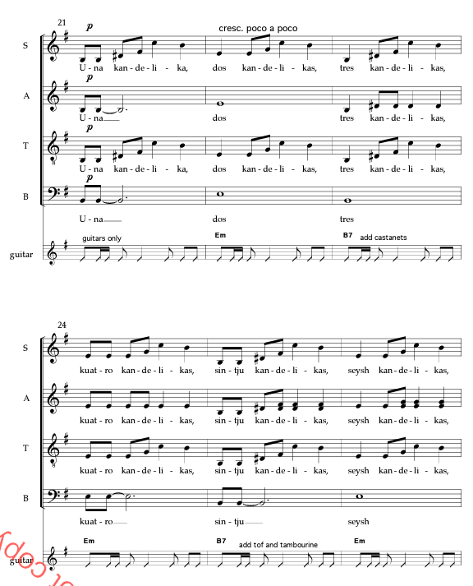

Slide 18
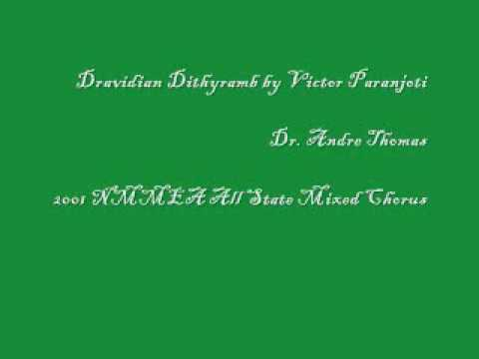
Dravidian Dithyramb by Victor Paranjoti, Edited by Andre de Quadros
SATB unaccompanied South Indian Hymn of Praise
High School and beyond

Slide 19
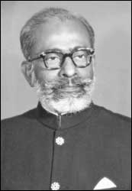
Victor Paranjoti
(1906-1967)
The founder and Conductor of the Bombay-based Paranjoti Choir.
"A pioneer in synthesizing Western and Eastern musical forms" (The Oxford Encyclopedia of the Music of India).

Slide 20
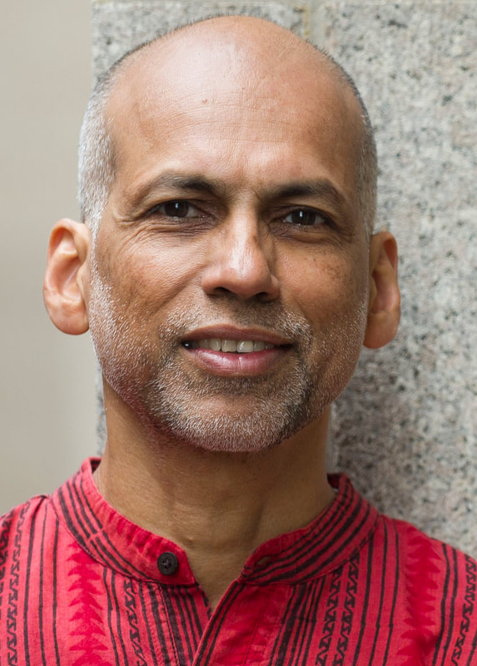
Andre de Quadros
Born in Bombay, India
conductor, ethnomusicologist, music educator, writer, and human rights activist
During the Iraq war, in 2008 and 2012, he co-directed Aswatuna: Arab Choral Festival in Jordan that brought together community choirs from Iraq, Jordan, Lebanon, Palestine, and Syria. Since 2010, he has co-directed the Community Heartsong, a historic project with young Palestinian and Israeli choral musicians in East Jerusalem working to foster understanding between the two communities.

Slide 21
Dravidian Dithyramb
Neutral syllables
Syncopated rhythms
Indian melodic motifs
Incorporates ragas from the Carnatic music of South India and
Tarana, a form of Hindustani classical music which uses Persian and Arabic phonemes as nonsense syllables

Slide 22
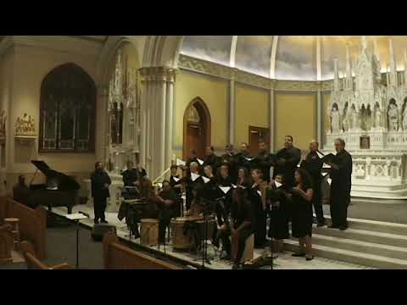
Alma Llanera ("Soul of the Plains"), Pedro Gutierrez/arr. Ángel Sauce
Advanced Junior High and beyond
Joropo (a Venezuelan dance form)

Slide 23
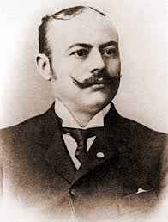
Pedro Gutierrez
1870-1994
led the Orquesta Caraqueña, a light music ensemble
Best known for composing Alma Llanera

Slide 24
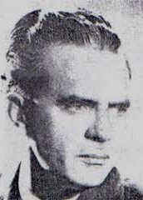
Ángel Sauce
1911-1995
Venezuelan composer, violinist, and conductor

Slide 25
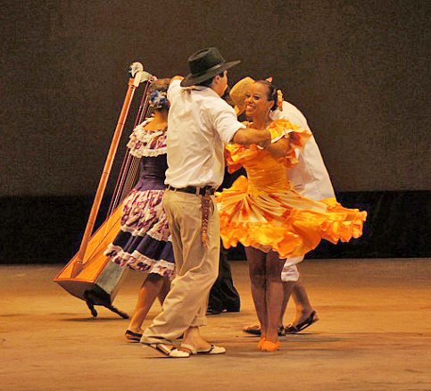
Alma Llanera
Title song of a Zarzuela, a Spanish lyric-dramatic opera
3/8 and 6/4 alternating
Considered the second Venezuelan national anthem
Traditionally closes a gathering (or even a concert!)
This Photo by Unknown author is licensed under CC BY-NC-ND.

Slide 26
Teaching Music outside your lived experience

Slide 27
Do your research
  Text translations
  Cultural significance
  Composer background and intent
2. Consult the experts
  Members of a given culture
  Scholars on the subjects (not the Facebook scholars)
3. Focus on why you are programming this music
  What experiences are you bringing top your singers
  What skills will they learn/improve?
  What challenges could happen?
  What lived experiences are you engaging with?

Slide 28
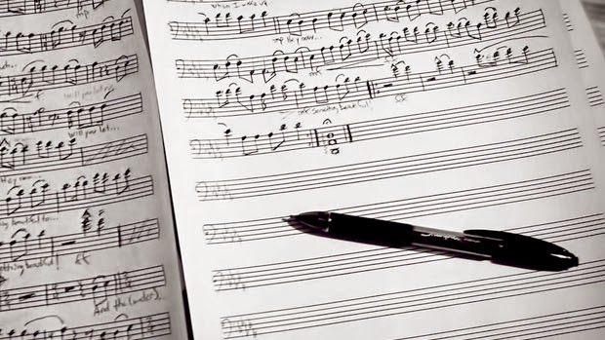
Arranging from the Public Domain
This Photo by Unknown author is licensed under CC BY-SA-NC.

Slide 29
Considerations for Native American/American Indian Music
Music is integral to spiritual practices
Should not be arranged flippantly
Permission from tribal leaders

Slide 30
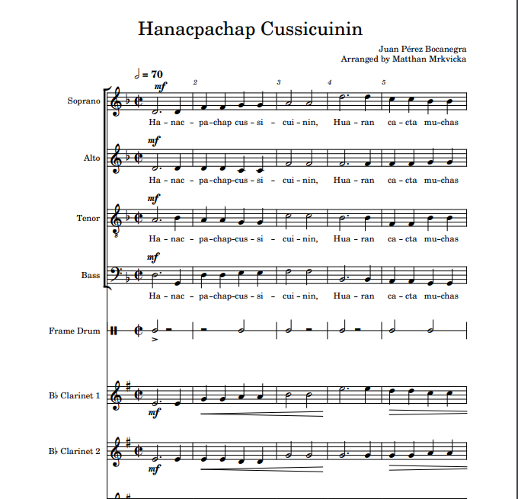
Hanacpachap cussicuinin by Juan Pérez Bocanegra
Quechua text
Two translated verses
Accessibility
Baroque styling
Processional use

Slide 31
Hanacpachap cussicuinin by Juan Pérez Bocanegra
Transcribed the SATB Voicing
Clarinet quartet colla parte
Simple percussion on frame drum
Alternated between Full Chorus, SA, TB, neutral syllable
Transitioned between UNO University Choirs on our 2022 Winter Concert

Slide 32
Why Are You Programing Indigenous Music?
  Honor members of your community?
  Topical/Current Events?
  Programming on a specific topic or musical culture?
  Aligning with standards or district policies?

Slide 33
Make Sure Your Programing Choices Are...
Intentional
Well Researched
Consistent

